Slide 1
Computer Science
Number theory
Samuel Lukas

Slide 2
Introduction
Basic concepts of number theory
Prime number and Greatest common Devisor
The applications of number theory in Computer Science

Slide 3
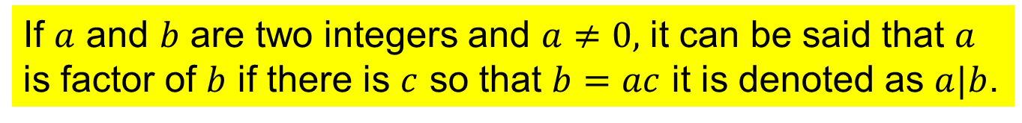
Basic Concepts
If $a$ and $b$ are two integers and $a≠0,$ it can be said that $a$ is factor of $b$ if there is $c$ so that $b=ac$ it is denoted as $a|b$.
Theorem 1 : $a\left|b , a\right|c then a|(b+c)$
Theorem 2 : $a\left|b then a\right|\left(bc\right) for every c is integer$
Theorem 3 : $a\left|b , b\right|c then a|c$
Theorem 4 : $a\left|b , a\right|c then a|\left(mb+nc\right), ∀m,n ε Integer$
Theorem 5 : $a\left|b , b\right|a then a=b or a=−b$
Theorem 6 : $a\left|c , b\right|d then ab|cd$
Theorem 7 : $ac|bc then a|b$
Theorem 8 : $a ε Z, dεZ^{+} Then ∃q!,r!, a=dq+r, 0≤r<d$
$$q=a div d and r=a mod d$$

Slide 4

Congruences
,
.
If $a$ and $b$ are integers and $m$ is positive integer the $a$ is congruence $b$ with modulo $m$, If $m$ is factor of $a−b$. It is denoted as $a≡b (mod m)$.
$17≡5 \left(mod 6\right) Because 6|(17−5)$
$$24 ≠14 \left(mod 6\right) Because 6 | (14−14)$$
Theorem 09 : $a≡b \left(mod m\right) ↔ a mod m=b mod m$
Theorem 10 : $a≡b \left(mod m\right) ↔ a =b+mk$
Theorem 11 : $a≡b \left(mod m\right) and c≡d mod m then a+c≡b+d (mod m)$
Theorem 12 : $a≡b \left(mod m\right) and c≡d mod m then ac≡bd (mod m)$
Theorem 13 : $\left(a+b\right) mod n=\left((a mod m)+(b mod m)\right) mod m$
Theorem 14 : $\left(ab\right) mod n=\left((a mod m)(b mod m)\right) mod m$

Slide 5
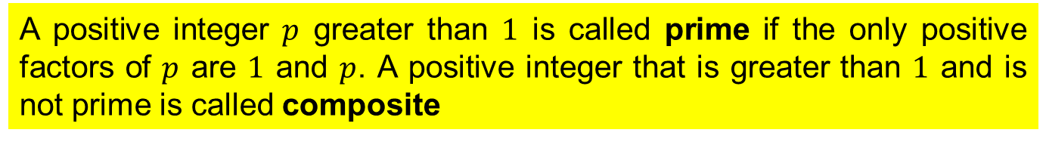
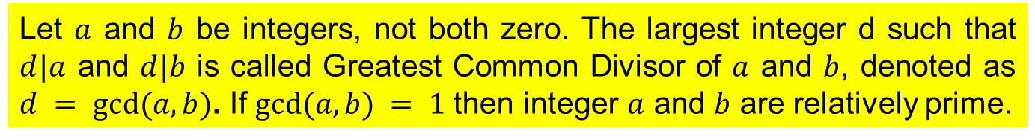
Prime Number and GCD
A positive integer $p$ greater than $1$ is called prime if the only positive factors of $p$ are $1$ and $p$. A positive integer that is greater than $1$ and is not prime is called composite
Every positive integer greater than 1 can be written uniquely as a prime or as the product of two or more primes where the prime factors are written in order of non-decreasing size.
If $n$ is composite integer, then $n$ has a prime divisor less than or equal to $\sqrt{n}$
There are infinitely many primes
Let $a$ and $b$ be integers, not both zero. The largest integer d such that $d|a$ and $d|b$ is called Greatest Common Divisor of $a$ and $b$, denoted as $d = gcd⁡(a,b)$. If $gcd⁡(a,b) = 1$then integer $a$ and $b$ are relatively prime.

Slide 6
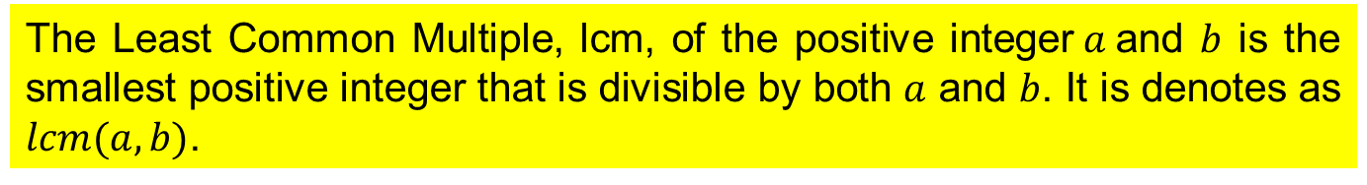
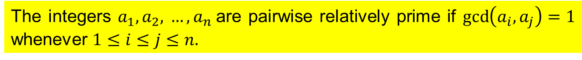

Prime Number and GCD (Cont)
The integers $a_{1},a_{2},$ $…, a_{n}$are pairwise relatively prime if $\gcd\left(a_{i},a_{j}\right)=1$ whenever $1≤i≤j≤n.$
The Least Common Multiple, lcm, of the positive integer$a$and $b$ is the smallest positive integer that is divisible by both $a$ and $b$. It is denotes as $lcm(a,b)$.
$$a=p_{1}^{a_{1}}p_{2}^{a_{2}}…p_{n}^{a_{n}} and b=p_{1}^{b_{1}}p_{2}^{b_{2}}…p_{n}^{b_{n}}$$
$$gcd (a,b)=p_{1}^{min (a_{1},b_{1})}p_{2}^{min (a_{2},b_{2})}…p_{n}^{{min (a}_{n},b_{n})}$$
$$lcm (a,b)=p_{1}^{max (a_{1},b_{1})}p_{2}^{max (a_{2},b_{2})}…p_{n}^{{max (a}_{n},b_{n})}$$
$$ab=gcd\left(a,b\right)∙lcm(a,b)$$

Slide 7




Greatest Common Divisor
Let $a=bq+r$, where $a,b,q and r$ are integers, then $\gcd\left(a,b\right)=gcd⁡(b,r)$.
Suppose $d$ divides $a$ and $b$, $d\left|a, d\right|b→d|a−bq →d|r$
Suppose $d$ divides $b$ and $r$, $d\left|b, d\right|r→d|bq+r →d|a$
Therefore, any common divisor of $a$ and $b$, is also common divisor of $b$ and $r$
The problem is $\gcd\left(a,b\right)= ?$
If $a≥b let r_{0}=a and r_{1}=b$. It can be written as
$${ r}_{0}=r_{1}q_{1}+r_{2} 0≤r_{2}<r_{1}$$
$$r_{1}=r_{2}q_{2}+r_{3} 0≤r_{3}<r_{2}$$
$$r_{n−2}=r_{n−1}q_{n−1}+r_{n} 0≤r_{n}<r_{n−1}$$
$$r_{n−1}=r_{n}q_{n}$$
$$the squence of reminders b divides a is r_{2}>r_{3}>…>r_{n}≥0$$
$$∴gcd\left(a,b\right)=\gcd\left(r_{0},r_{1}\right)=\gcd\left(r_{1},r_{2}\right)= …=\gcd\left(r_{n−1},r_{n}\right)=\gcd\left(r_{n},0\right)= r_{n}$$

Slide 8







Example 01
$$\gcd\left(414,662\right)= ?$$
The Euclidean algorithms is
Procedure gcd(a,b : positive integers )
$$662=414∙1+248$$
$$414=248∙1+166$$
x := a
$$248=166∙1+82$$
y := b
$$166=82∙2+2$$
While $y≠0$
Begin
$82=2∙41+0$
r := x mod y
$$∴gcd\left(414,662\right)=2$$
x := y
y := r
End { gcd(a,b) is x }

Slide 9
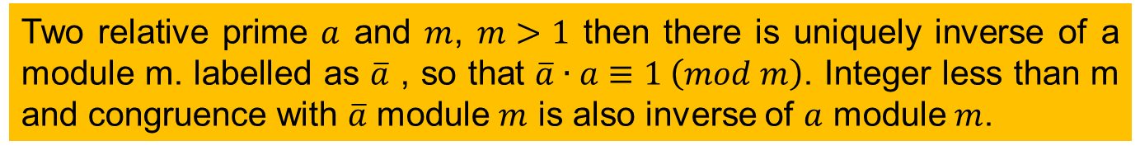

Inverse number
Two relative prime $a$ and $m$, $m>1$ then there is uniquely inverse of a module m. labelled as $\overline{a}$ , so that $\overline{a}∙a≡1 \left(mod m\right)$. Integer less than m and congruence with $\overline{a}$ module $m$ is also inverse of $a$ module $m$.
Example : Find inverse of 3 modulo 7
Since $gcd⁡(3,7)=1$ then there will be inverse of 3 modulo 7.
$7 = 2 ∙ 3 + 1 → −2 ∙ 3 + 7 = 1 → \overline{3}∙3≡1 (module 7)$ then $\overline{3}=−2$
then inverse of $3$ modulo $7$ is $−2$
Other integers that are congruence with $−2$ modulo $7$ are also inverse of $3$ modulo $7$ such as $5$, -$9$,$12$, etc.

Slide 10
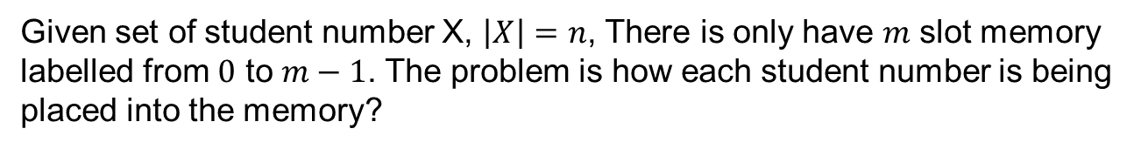
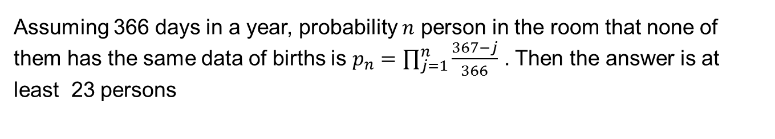
Applications of Number Theory
Hashing function
Given set of student number X, $\left|X\right|=n$, There is only have $m$ slot memory labelled from $0$ to $m−1$. The problem is how each student number is being placed into the memory?
With number of slot memory $m = 111$ then student number $x$ is located in slot memory number $y$ where $y = x mod m$
The Birthday Problem.
What is minimum number of person in a room to guarantee that at least there are two person have the same date of births with probability greater that ½..
Assuming 366 days in a year, probability $n$ person in the room that none of them has the same data of births is $p_{n}=\prod_{j=1}^{n}{\frac{367−j}{366}}$ . Then the answer is at least 23 persons

Slide 11

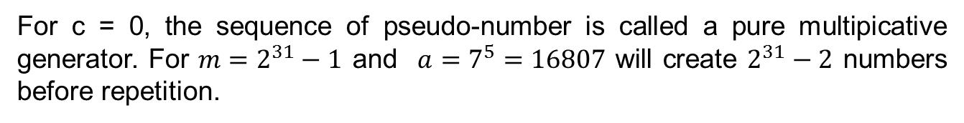

Pseudo-Numbers
Having $m$, $a$ ,$c$ and $x_{0}$, they can create a sequence of integer uniquely before repetition. By using $x_{n+1}=\left(ax_{n}+c\right) mod \left(m\right).$
For $m=9$, $a=7$ ,$c=4$ and $x_{0}=3$, then the sequence of integer $x_{n}$ is
$X_{n}=${3,7,8,6,1,2,0,4,5,3,7,8,6,…}
For c = 0, the sequence of pseudo-number is called a pure multipicative generator. For $m=2^{31}−1$ and $a=7^{5}=16807$ will create $2^{31}−2$ numbers before repetition.

Slide 12


Criptography
Plaintext
Chippertext
Plaintext
Encription
Decription
Plain text : MEET YOU IN THE PARK
Chipper text : PHHW BRQ LQ WKH SDUN
$x$ is numerical value of a plain character $X$
$y$ is numerical value of a chipper character of $Y$
$$c\left(x\right)=y=(x+3) mod (26)$$
$$p\left(y\right)=(y−3) mod (26)$$

Slide 13
International Standard Book Number
Book code
Publisher code
Language
Check digits
ISBN = 0-07-053965-0
ISBN = 0-07-123374-1

Slide 14
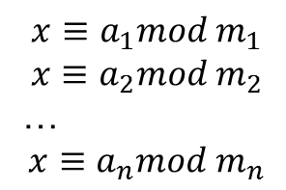
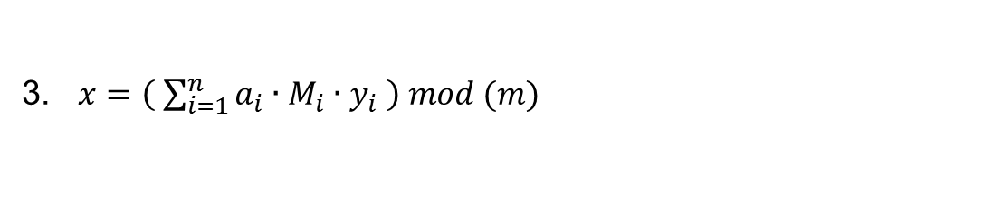


Chinese Remainder
Chinese Mathematician, Sun-Tzu, argue what number is that if it is divided by 3 or 7 will remain 2. But if it is divided by 5 will remain 3.
Suppose $m_{1}, m_{2}, …, m_{n}$ are pairwise relatively prime, the simultaneously equation
$$x≡a_{1}mod m_{1}$$
$$x≡a_{2}mod m_{2}$$
…
$$x≡a_{n}mod m_{n}$$
Then $0≤x≤m_{1}m_{2}…m_{n}$
The steps are :
1. ${m= m}_{1}m_{2}…m_{n}$
2. $∀kε\left\{1,2,…,n\right\}, {M_{k}=\frac{m}{m}}_{k} →∃y_{k}, y_{k}=\overline{M_{k}}$
3. $x=\left( \sum_{i=1}^{n}{a_{i}∙M_{i}∙y_{i}} \right) mod (m)$
Therefore the answer of the problem above is 23

Slide 15

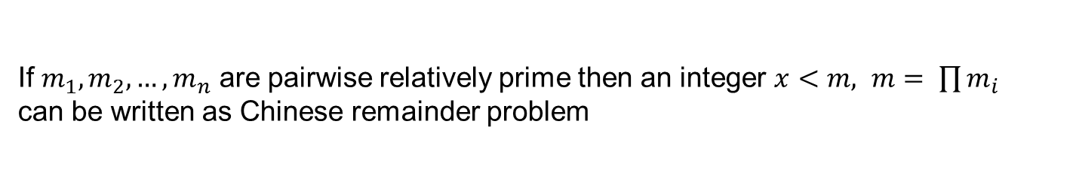
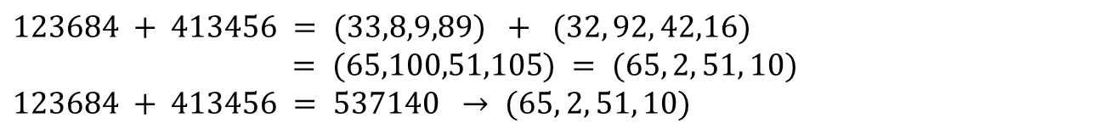
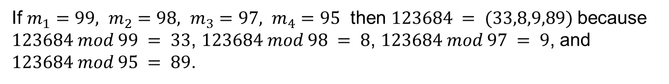
Calculation with big Integer
If $m_{1}, m_{2}, …, m_{n}$ are pairwise relatively prime then an integer $x<m, m= \prod{m_{i}}$ can be written as Chinese remainder problem
$x=(x mod m_{1},x mod m_{2},$ …, $x mod m_{n})$
If $m_{1}=99, m_{2}=98, m_{3}=97, m_{4}=95$ then $123684 = (33,8,9,89)$because $123684 mod 99 = 33$, $123684 mod 98 = 8$, $123684 mod 97 = 9$, and $123684 mod 95 = 89$.
$123684 + 413456 = (33,8,9,89) + (32, 92, 42,16)$
$= (65,100,51,105) = (65, 2, 51, 10)$
$$123684 + 413456 = 537140 → (65, 2, 51, 10)$$

Slide 16

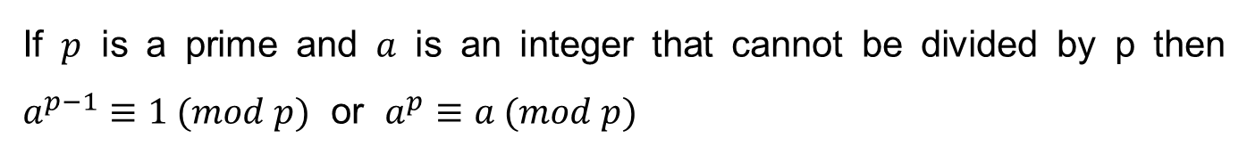


Fermat Theory
If $p$ is a prime and $a$ is an integer that cannot be divided by p then $a^{p−1}≡1 (mod p)$ or $a^{p}≡a (mod p)$
Examples :
$$2^{4}mod 5= ?$$
$$(a=2) ∧(p=5)∧(2|5) →2^{4}≡1 (mod 5)$$
$$2^{340}mod 341= ?$$
$$(a=2) ∧(p=341)∧(2|341) →2^{340}≡1 (mod 341)$$
$$3^{302}mod 5= ?$$
$$(a=3) ∧(p=5)∧(3|5) →3^{4}≡1 (mod 5)$$
$3^{302}mod 5= \left({\left(3^{4}\right)}^{75}(3^{2})\right) mod 5=3^{2}$ mod 5 = 4

